Slide 1
SENTIMENT ANALYSIS OF MOVIE REVIEWS NAÏVE BAYES AND RULE-BASED ALGORITHM
TEAM MEMBERS : Poorani Jagadeesan, Thanate Banchonhattakij, Yashwanth Gangapuram
Notes:
The following presentation discusses the background of sentiment mining movie reviews, provides a brief introduction to Naïve Bayes and rule-based algorithm, challenge resolution and implementation of the algorithms in R and finally analysis of their results followed by conclusion.

Slide 2
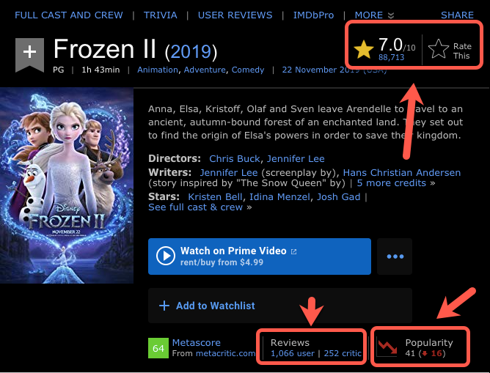
BACKGROUND
Analysis of movie reviews
Polarity
Rating
Popularity
Notes:
This slide shows the IMDB page of a popular movie and some interesting statistics highlighted in red. The popularity of the movie, the number of reviews and how they have affected the overall rating of the movie. Our project aims to understand the classification of movie reviews into positive or negative based on the sentiment words expressed in each of the sentences.

Slide 3
INTRODUCTION
Naïve Bayes algorithm
Build Naïve Bayes model to automatically learn, identify, and predict the polarity of movie reviews.
Improve model performance by Laplace smoothing.
Rule-based sentiment analysis
Compare the words from the reviews with the ‘nrc’ and ‘bing’ lexicons to identify and polarize the words of movie reviews.
Notes:
An attempt is made to classify movie reviews as positive or negative using the probabilistic Naïve Bayes model and rule-based algorithm discussed in the following slides.

Slide 4

NAÏVE BAYES ALGORITHM
Bayes Theorem : $P\left(A | B\right)=\frac{P\left(A∩B\right)}{P\left(B\right)}=\frac{P\left(B | A\right)P\left(A\right)}{P\left(B\right)}$
Probabilistic model:
Laplace smoothing: To reduce the number of false positives and negatives.
 | Good |  | Bad |  | Success |  | Poor
Likelihood | Yes | No | Yes | No | Yes | No | Yes | No | Total
Pos | 35/50 | 15/50 | 6/50 | 44/50 | 32/50 | 18/50 | 4/50 | 46/50 | 50
Neg | 2/50 | 48/50 | 43/50 | 7/50 | 13/50 | 37/50 | 33/50 | 17/50 | 50
Total | 37/100 | 63/100 | 49/100 | 51/100 | 45/100 | 55/100 | 37/100 | 63/100 | 100
Notes:
The Naïve Bayes classifier algorithm uses Bayes probabilistic theorem to form a model that uses conditional probability to predict the class of the variables based on prior probability.
The likelihood table presents a simple illustration of the presence of four words “good”, “bad”, “success” and “poor” in a set of total 100 movie reviews. Taking the word “good”, we see that it is strongly present in positive reviews, and hence a movie review having the word “good” has a strong probability of being a positive review. Similarly, each of the words prior probability is taken into account for predicting the polarity of the movie review.
Problem arises when the probability of a word occurring in a class is zero. For example, if the occurrence of the word ”Success” in a negative review is zero it affects the entire probability, since the probabilistic model is a multiplication formula and multiplying with zero produces an error. The solution is, introduction of a Laplace estimator equal to 1 here, for introducing a minimum probability occurrence in each class.

Slide 5
RULE-BASED SENTIMENT ANALYSIS
Manual Rules for sentiment analysis – nrc lexicon:
sentiment_result <- movie_review %>% left_join(get_sentiments("nrc"))
%>% filter(!is.na(sentiment))
%>% count(sentiment, sort = TRUE)
Sentiment analysis – bing lexicon:
sentiment_result <- tidy(mr_dtm) %>% left_join(get_sentiments("bing"), by = c(term = "word"))
Notes:
Manually designed rules and exploiting the pre-existing lexicons available in R for classifying sentiments in large movie review datasets is called rule-based sentiment analysis. This slide shows the two important lexicons that classify words into sentiments. The ‘nrc’ lexicon splits words into 10 categories of emotions, namely, positive, negative, anger, anticipation, disgust, fear, joy, sadness, surprise, and trust with a yes or no connotation. The ‘bing’ lexicon, on the other hand, is another English language sentiment lexicon that classifies words into positive or negative based on emotion in a binary fashion.
Another important item to note here, is the use of right_join since it combines all the rows of movie review with the rows that match in the lexicon.

Slide 6
RULE-BASED SENTIMENT ANALYSIS
sentiment_count <- sentiment_result %>%
count(document, sentiment, wt = count) %>%
spread(sentiment, n, fill = 0) %>%
mutate(sentiment = positive - negative) %>%
mutate(type = ifelse(sentiment >= 0, "pos", "neg"))
Notes:
After combining our movie review words with the corresponding lexicon, rules are applied to calculate the net sentiment in the ”bing” lexicon. The count of the sentiments with net positive and net negative sentiments are calculated and the movie review with net positive sentiments are classified as positive and vise-versa. Here the net sentiment is considered to be positive when it s greater than or equal to zero.

Slide 7
CHALLENGE RESOLUTION
Data preparation
Noisy text data
Tidytext functions
Visualization
sentiment distribution
Wordclouds, plots
stemDocument
Cuts out words
Replace, omit
Model performance
Low accuracy
Change parameters

Slide 8
IMPLEMENTATION
Naïve Bayes algorithm
Naïve Bayes algorithm without the Laplace smoothing
Naïve Bayes algorithm with the Laplace smoothing
Rule-based sentiment analysis
NRC lexicon: Categorizing words in a binary fashion (“yes”/“no”) into categories of positive, negative, anger, anticipation, disgust, fear, joy, sadness, surprise, and trust.
BING lexicon: Categorizing words in a binary fashion into positive and negative categories.

Slide 9
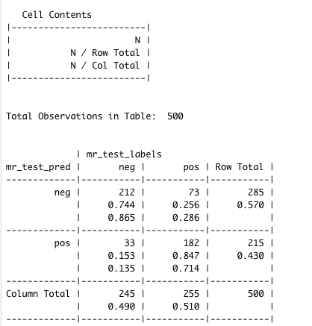
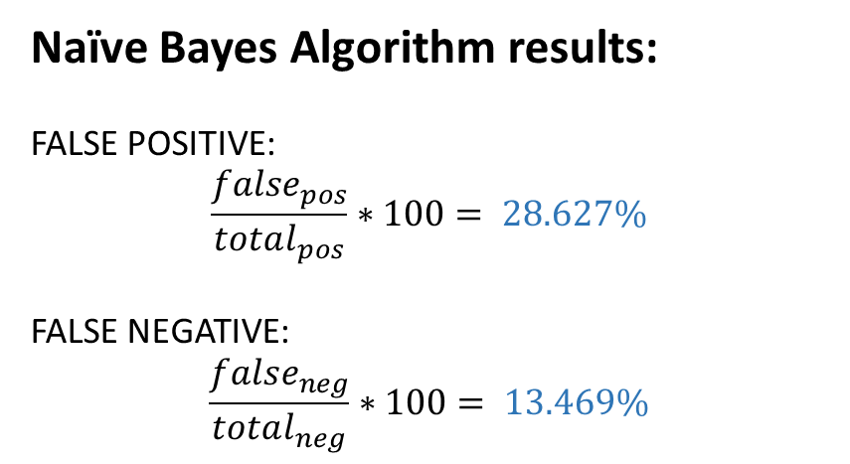
NAÏVE BAYES ALGORITHM
Naïve Bayes Algorithm results:
FALSE POSITIVE:
$$\frac{false_{pos}}{total_{pos}}∗100= 28.627\%$$
FALSE NEGATIVE:
$$\frac{false_{neg}}{total_{neg}}∗100= 13.469\%$$
Notes:
Data cleaning and processing is performed on a set of 2000 movie reviews where 1000 are labeled positive and 1000 negative. Applying the Naïve Bayes algorithm, after splitting 1500 reviews into training data and 500 reviews into testing data by randomly splitting them, the crosstable of predicted vs actual polarity labels is obtained. Clearly, we can see that the algorithm predicts the positive and negative reviews with good confidence with some false negative and false positive values. We find this model satisfactory in terms of polarity classification and move on to rule-based sentiment anlaysis.

Slide 10
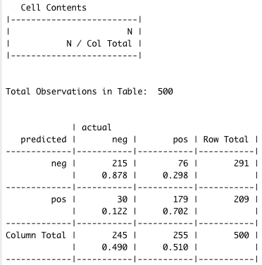
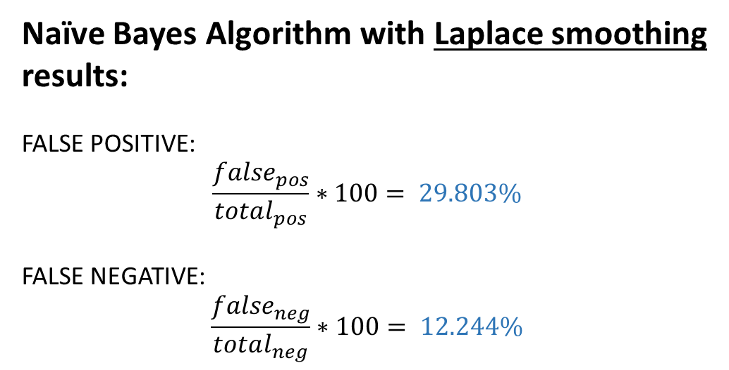
NAÏVE BAYES ALGORITHM
Naïve Bayes Algorithm with Laplace smoothing results:
FALSE POSITIVE:
$$\frac{false_{pos}}{total_{pos}}∗100= 29.803\%$$
FALSE NEGATIVE:
$$\frac{false_{neg}}{total_{neg}}∗100= 12.244\%$$

Slide 11
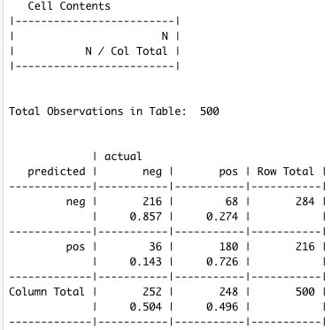
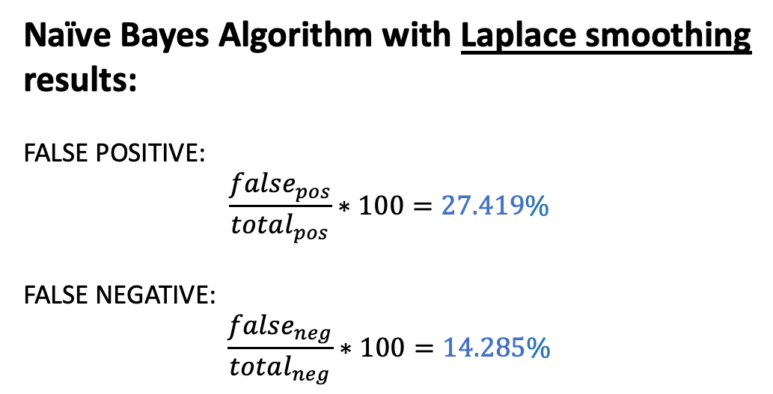
NAÏVE BAYES ALGORITHM
Naïve Bayes Algorithm with Laplace smoothing results:
FALSE POSITIVE:
$$\frac{false_{pos}}{total_{pos}}∗100=27.419\%$$
FALSE NEGATIVE:
$$\frac{false_{neg}}{total_{neg}}∗100=14.285\%$$

Slide 12
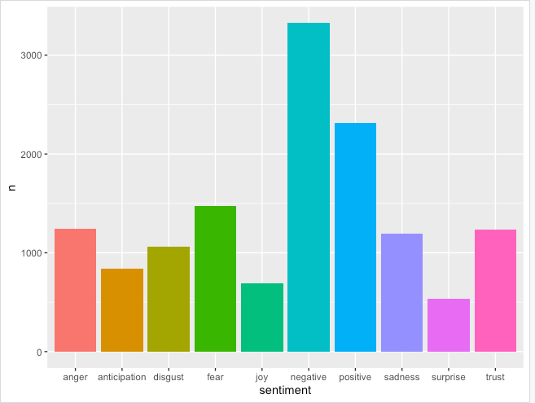
SENTIMENT CLASSIFICATION - NRC
Notes:
The count of each sentiment words appearing in the movie reviews are visualized here to understand the general trend of each emotion corresponding to the ‘nrc’ lexicon. This information could be applied to specific movies and if the general trend reflects anger and negative emotions, then it can be concluded that the particular movie evoked such reactions among the reviewers and corrective action can be taken. General discontent can be measured in this way for understanding the cause and solution for such reactions.

Slide 13
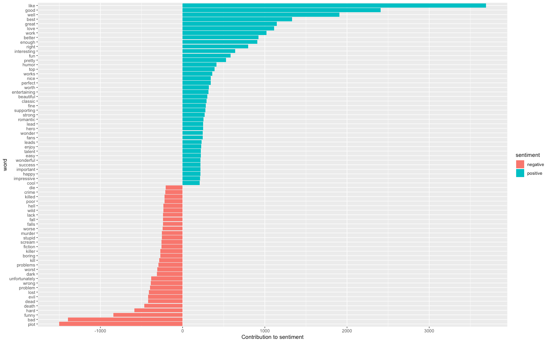
RULE-BASED RESULTS – BING LEXICON
Notes:
A classification of sentiment words based on the ‘bing’ lexicon offers the use and frequency of the positive and negative emotions expressed in movie reviews. Some of the words are pretty straight forward in the sense that it can be fairly obvious that the word ’like’ is used most often and this reflects the attitude of the reviewer to a movie. However, the classification of the words ’death’, ‘hard’, and ‘plot’ into negative categories is not clear as the words can refer to positive or negative emotions based on the context and usage in the sentences of the movie review. Such analysis can be useful in gauging the most used words to express the type of emotion and how it affects the overall polarity of a movie review.

Slide 14
ANALYSIS OF RESULTS
Both analysis identify positive and negative movie reviews.
Naïve Bayes algorithm
The model of Naïve Bayes algorithm help to identify and predict the positive and negative words in the reviews, so the machine learning learns more train data, better and effective results.
Rule-based sentiment analysis
The rule-based sentiment analysis help to perform sentiment analysis based on a set of manually crafted rule, so if the bigger set, better performance.

Slide 15
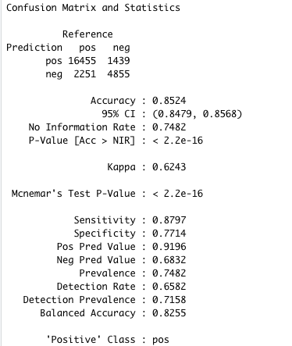
ANALYSIS OF RESULTS
Performance of Naïve Bayes algorithm on large movie review data set

Slide 16
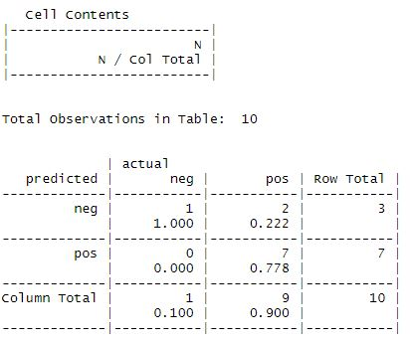
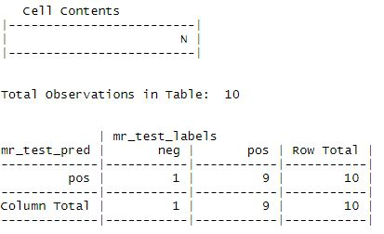
CONCLUSION
The comparison of both sentiment analysis (the reviews in a movie):
Train data (20 reviews) and Test data (10 reviews)
Naïve bayes algorithm
Rule-based algorithm
Notes:
In terms of polarity classification of movie reviews, the Naïve Bayes algorithm performed better than manual rule-based algorithm, since it is simple to implement, easier to understand and intuitive to train and predict using the given dataset. The rule-based algorithm needs subject based knowledge and custom fitted rules to extract more meaningful data from the movie review dataset.
Thank you for reviewing our presentation.

Slide 17
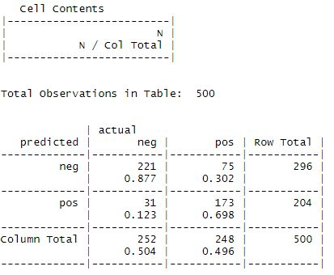
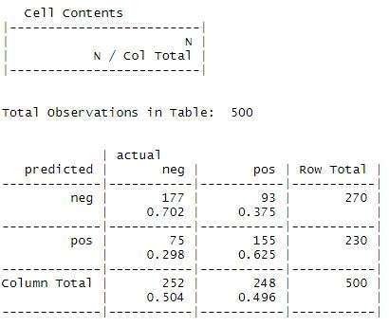
CONCLUSION
The comparison of both sentiment analysis (the reviews in movies):
Train data (1500 reviews) and Test data (500 reviews)
Naïve Bayes algorithm
Rule-based algorithm

Slide 18
REFERENCE
Mohammad Saif M. (2016) National Research Council Canada: The Sentiment and Emotion Lexicons Retrieved from http://sentiment.nrc.ca/lexicons-for-research/ [1]
Hu Xu, Bing Liu, Lei Shu and Philip S. Yu. (2004) Opinion Mining, Sentiment Analysis, and Opinion Spam Detection Retrieved from https://www.cs.uic.edu/~liub/FBS/sentiment-analysis.html [2]
Lantz Brett (2015) Machine Learning with R, 2nd ed, Livery Place: Packt Publishing Ltd.
Meyer David, and Xue Jinghao (n.d.) Naïve Bayes Classifier Retrieved from
http://math.furman.edu/~dcs/courses/math47/R/library/e1071/html/naiveBayes.html
Silge Julia, and Robinson David (2020) Introduction to tidytext Retrieved from https://cran.r- project.org/web/packages/tidytext/vignettes/tidytext.html
Wickham Hadley (n.d.) Dplyr part of the tidyverse: Join two tbls together Retrieved from https://dplyr.tidyverse.org/reference/join.html

